Slide 1
Phishing link detector
Team : nazia afroze
keerthi

Slide 2

Introduction
Phishing steals sensitive information
Targets: passwords, bank details, personal data
Fake websites look like real platforms
System helps protect users online

Slide 3

Problem Statement
Users cannot easily identify phishing websites
Leads to theft of sensitive data
Need a system to detect phishing links
Increasing frequency of phishing attacks makes online activities unsafe

Slide 4
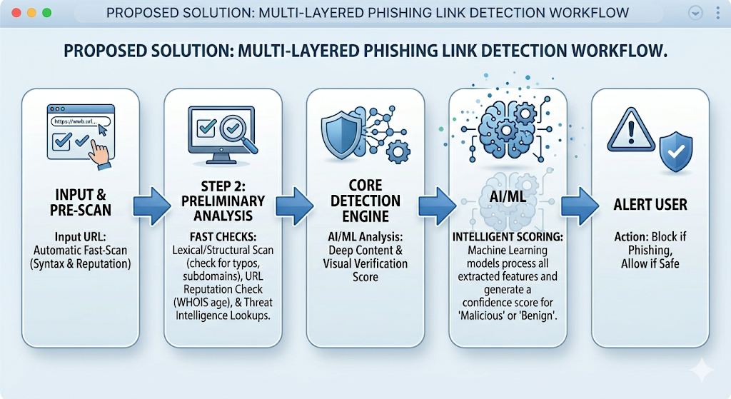
Proposed Solution
Analyze URL features (length, HTTPS, suspicious words)
Classify as Safe / Phishing
Alert user in real-time

Slide 5
How It Works
Steps:
User enters a website URL.
System analyzes key features:
URL length
HTTPS (secure connection)
Suspicious words / patterns
Algorithm classifies website as Safe or Phishing.
Result displayed and user alerted instantly.

Slide 6
Example URLs:
Safe Websites:
https://www.google.com⁠✅
https://www.amazon.com⁠✅
Phishing Websites (Demo purpose):
http://secure-login-amazon.xyz⁠❌
http://verify-paypal-account.free⁠❌

Slide 7
features
Quick & Accurate Detection
Analyzes URL Features
Real-Time Alerts
User-Friendly Interface
Handles Known & Unknown URLs

Slide 8
Future Scope
Future Scope
Browser extension for real-time protection
Mobile app development
Improve AI/ML algorithms
Add email phishing detection
Continuous dataset updates

Slide 9

Conclusion
Phishing is a major cyber threat
System identifies malicious websites effectively
Improves online safety & awareness
Can extend for apps & AI

Slide 10
Thank you

